Slide 1
Mission 9 Remix
Create your own project from Mission 9

Slide 2
Warm-up
Mission 9 introduced functions, parameters and arguments.
In your Mission 9 Remix Log, answer the pre-mission preparation questions:
What is a function?
What is the difference between a parameter and an argument?

Slide 3
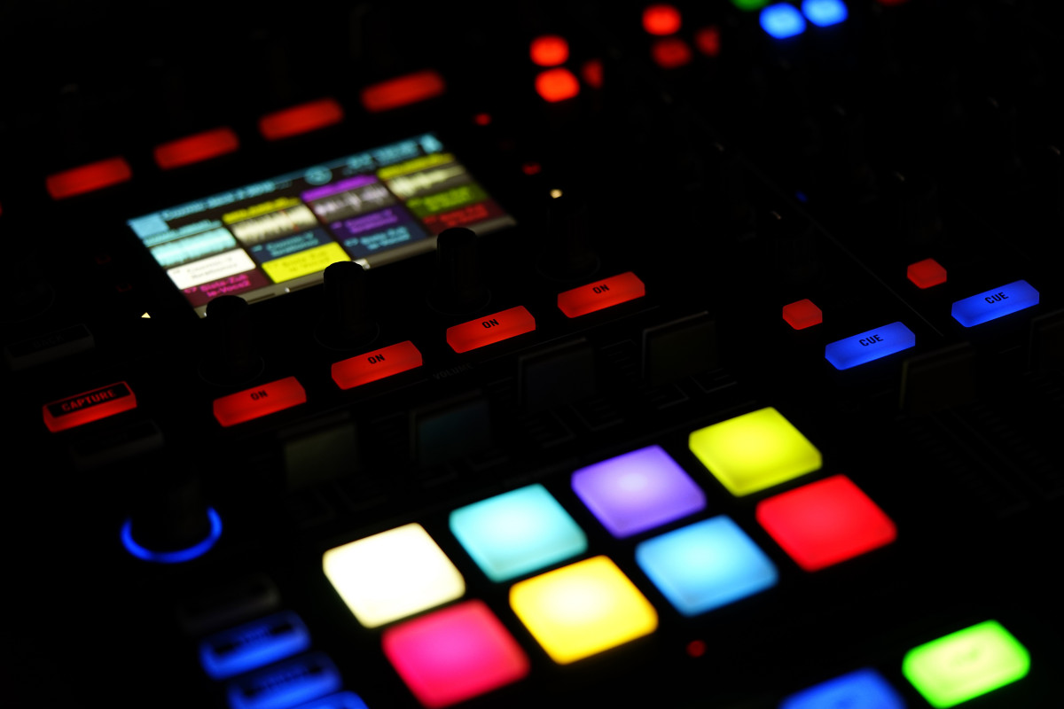
Time for a project remix!
A remix can be:
A new program created by adding new code to a program you already created
You can combine parts of two or more programs in a remix
Use a similar idea in a different way

Slide 4
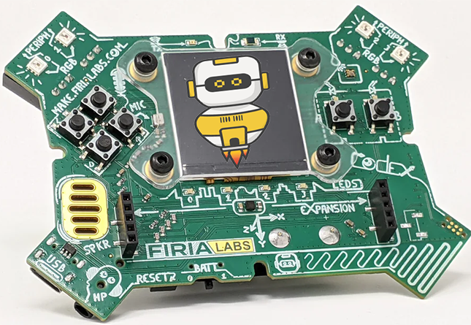
Project Remix
Creating a remix will let you:
Improve your skills and practice the concepts from the mission
Be creative
Remember code from earlier programs and missions
Work with other students
Design an original program and write the code all on your own

Slide 5
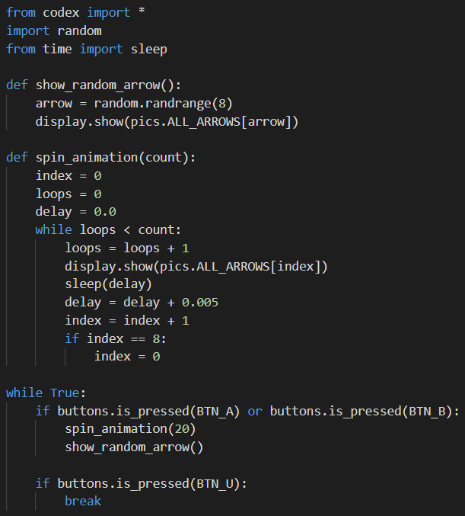
Step #1
Review the mission
Open your project from Mission 9
What does the program do?
What skills were used or concepts learned?
DO THIS:
Fill out the information in the Mission 9 Remix Log for Step 1

Slide 6
Step #2
Brainstorm ideas
Read through remix suggestions from your teacher
Ten suggestions are on the next 3 slides. You can use any of these ideas or come up with your own.

Slide 7
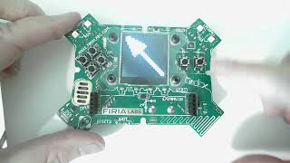
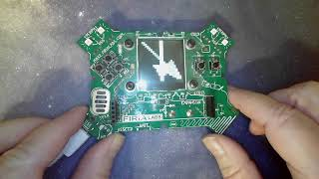
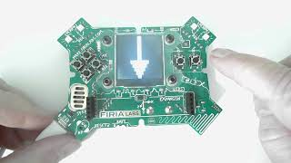
Step #2 Remix Ideas
Mild-1A
Create a function that will give an introduction and wait to start the game spinner. Then add a button to break out of the infinite loop and end the program with a message.
Mild-1B
Add a beep for each arrow spin.
Mild-1C
Make the animation spin counterclockwise instead of clockwise
Ctrl-Click on images to see videos

Slide 8
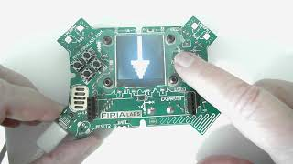
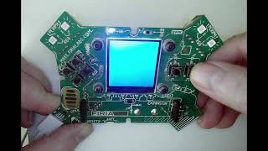
Step #2 Remix Ideas
Medium-2B
Many games use colors, numbers or specific images on the wheel. Show a random color (or large number) on the screen. Instead of ending with a random arrow, get a random number for count and whatever is showing at the end is the selection. (Only one function needed)
Medium-2A
Use BTN_A for spinning clockwise and BTN_B for spinning counterclockwise.
Ctrl-Click on images to see videos

Slide 9
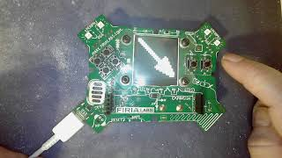
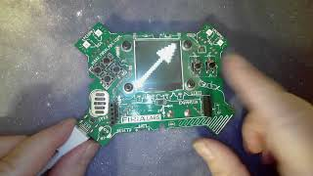
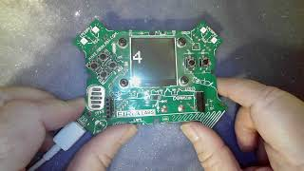
Step #2
Spicy-3B
Create another list and use a different beep for each arrow.
Spicy-3C
Create a 2-player game. Each player presses their own button. Use the dice roll or assign points to the arrows or colors. The first player to a point value wins.
Spicy-3A
Use both Button A and Button B for two different things. For example, use button A for the arrow spin and button B for the dice roll. Or button A for arrow spin and button B for colors.
Ctrl-Click on images to see videos

Slide 10
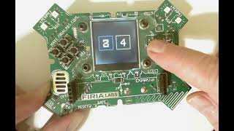
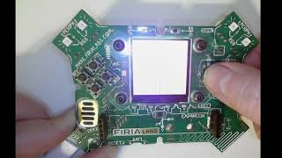
Step #2
Extra Spicy-4B
Create a color-match game. Display two rectangles, each with a random color. How long does it take to get matching colors?
Extra Spicy-4A
Many games use two dice. Create a program that rolls two dice at the same time.
Ctrl-Click on images to see videos

Slide 11
Step #2
Brainstorm ideas
Read through remix suggestions from your teacher (previous slides)
Use the suggestions as presented, or combine some of the options for your own mild, medium, spicy or extra spicy project
Use your creativity to come up with your own idea for a project
Decide with your partner what project you will do
DO THIS:
Fill out the information in the Mission 9 Remix Log for Step #2

Slide 12
Step #3
Make a plan
What variables will you need? What will you use them for?
What functions will you create for the program?
What lists will you use, and what will information will they store?
What buttons will you program, and what will each button do?
DO THIS:
Fill out the information in the Mission 9 Remix Log for Step #3

Slide 13
Step #4
Code your project
IMPORTANT: In CodeSpace, go to the sandbox
Start with a new file and give it a descriptive name (Remix9)
You can leave any program open, including Game Spinner, and use it as a guide
Import your modules
Create your lists and define your variables
Write your code, testing frequently

Slide 14
Step #4
Stop and test frequently!
Don’t try to write all the code at one time
Think about the steps:
Just get one thing to work, then move on
Step by step!
Mistakes happen, so find them early
Type just a few lines of code and then run the program
If there is an error, fix it before continuing
Use the debugger and your other programs for help

Slide 15
Step #5
Documentation!
Make sure your code is readable by adding blank lines
Add comments to sections of your code that explain what they do

Slide 16
Step #5
Get feedback
Show your code to other students.
What do they think? Have them fill out the feedback form on your Mission 9 Remix Log.
The Mission Log has space for two people to give feedback. The feedback can come from two peers or one peer and yourself.
Modify your code to make your project even better

Slide 17
And now you have your own remix!
Congratulations!
By completing this remix you have:
learned more about programming
practiced the skills and concepts from the missions
been thinking! And problem solving and much more!

Slide 18
Mission Reflection
Wow! Great job!
Share your project with your friends!
Run projects from other students
Complete your Mission 9 Remix Log
Don’t forget to clear your CodeX by running your Clear program

